Slide 1
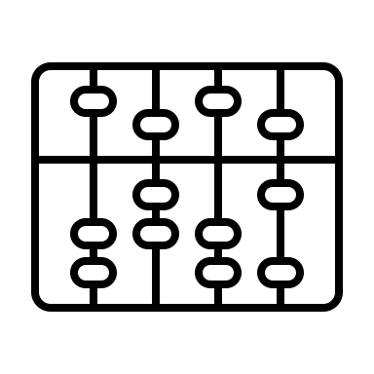

Data Management Schema for NWFSC OA Lab (CB Div)
Danielle Perez, Kate Rovinski (2021.03.03 Wednesday)

Slide 2

Chapter 1
Overview

Slide 3
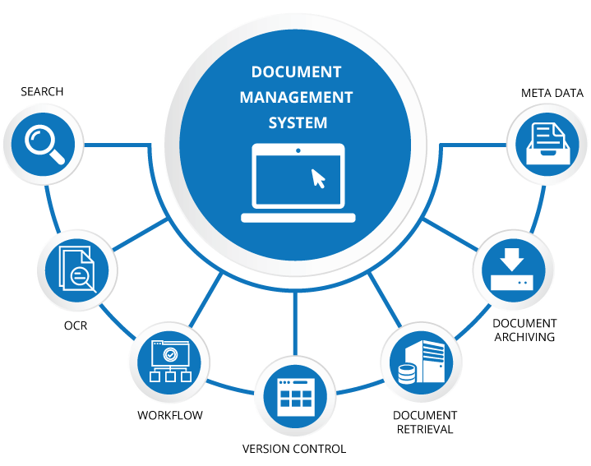
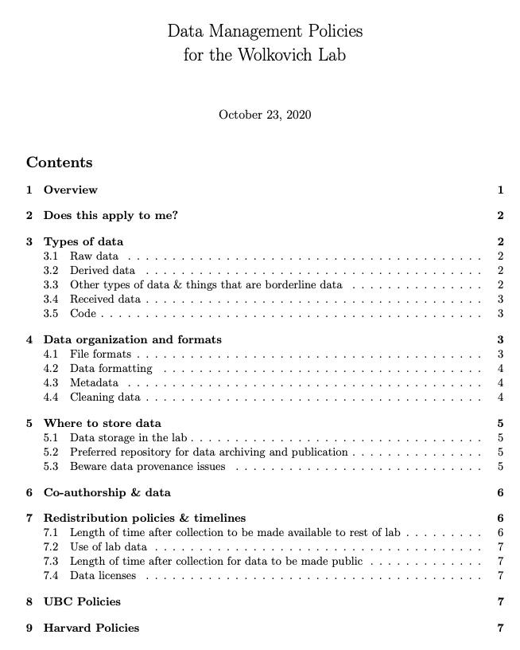

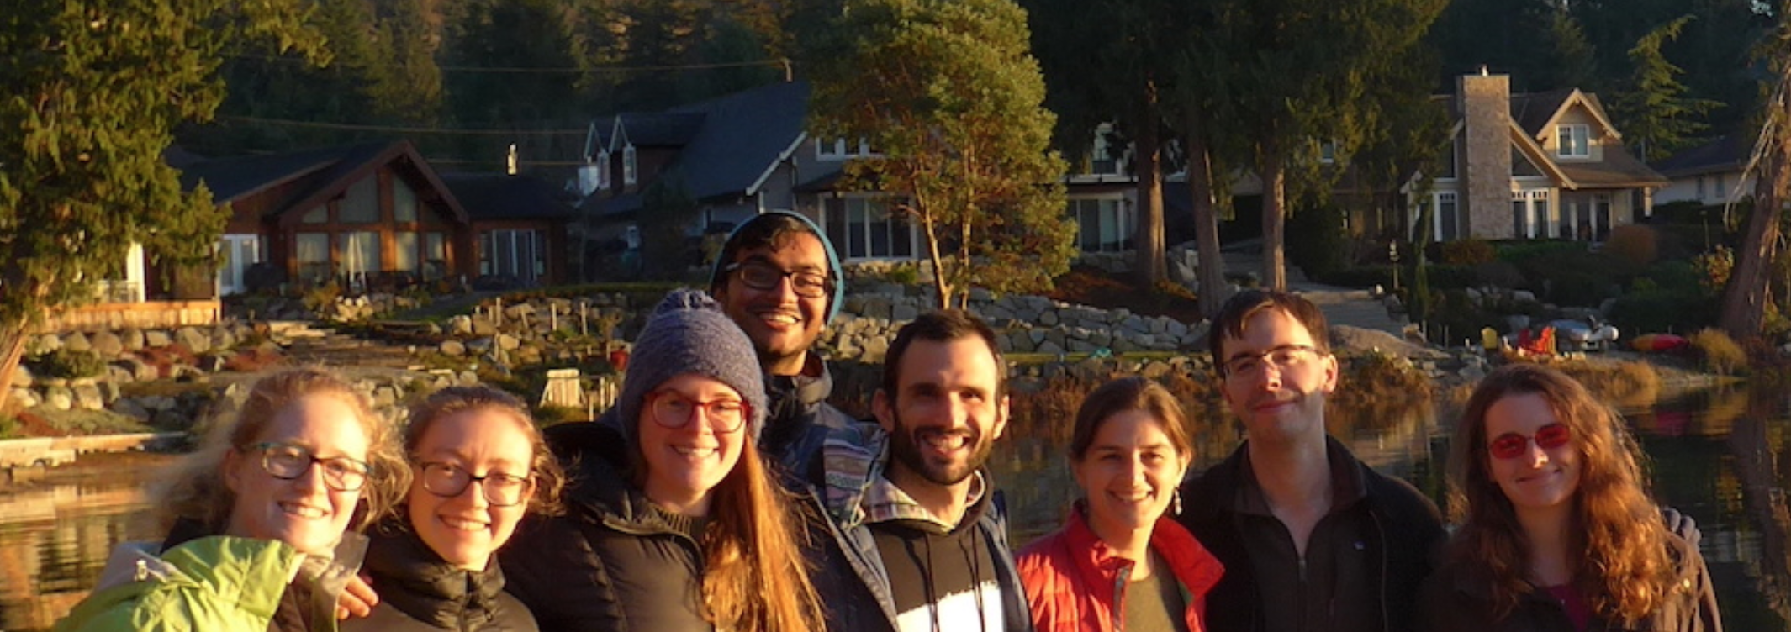

Input: Wolkovich Lab Document
Items Not Covered:
Questions for NWFSC lab:
How to handle field notes
How to designate processed/derived data
What is the threshold for received data? Should the lab accept derived data without raw data w/ commented metadata files?
How to handle version control of received data
Clear guideline when creating raw data- when first collecting
how to handle logs - “green book” guidance - event calendars - is that data? yes...

Slide 4
Wolkovich Lab Document – Overview
Design to be useful both to those who collected the data and those reviewing data
Produce robust, re-usable data. Institute storage practices. Give the data a long lifespan.
How and where data should be stored
How data are shared within the lab
How data are managed beyond the lab
How to archive data.
Serve the researchers in the lab and meet data management requirements of funding agencies.

Slide 5
Ideas and Themes OA Lab– Overview Chapter
Identify the typical user
Application of this document to interns as well as central projects
Include naming overview first or link to another chapter?

Slide 6


“Departure from the Wolkovich template”
I think it’s a good idea to include in the first chapter
Recommend including overall best practices and simple naming conventions from the very start and confirm/reassert these practices in particular chapters
Naming Consistency Rules
Typical categorical variables & camelCase
Null Value Standardization
Date Standardization

Slide 7
Wolkovich Lab Document – Raw Data
Raw data = primary or source data
Raw data have not been processed to averages
Raw data = numerical or character data written on paper or electronically stored
PDF back ups of our files

Slide 8
Raw Data OA Lab Definition & Concepts
Primary source data
Filing of raw data
Degree of Data Cleaning
No data transformation
Naming of raw data
SPEC data (formula inside the raw data?) treated like instrument file where there is processing
Version control of raw data
instrument file are fancy raw data files

Slide 9
Wolkovich Lab Document – Derived Data
Output of raw data after some sort of processing
Examples:
mean first flowering date
slope values from a regression for different species
standard errors- other descriptive statistics

Slide 10
Processed/Derived Data- OA Lab Concepts
Data you have begun to transform
models
Aspirational
Blend with PMEL
habitat suitability indices (HSIs)
Descriptive statistics
Output – Plots

Slide 11
Wolkovich Lab Document – Not Quite Data
Data produced by model simulations
Have a Lizzie in your lab for questions on data organization
Field notes
Inventories
hardware
a record of consumables
Chemical Inventory

Slide 12
When it’s almost Data- OA Lab Concepts
Models – coming up with models
Aspirational
Calendar of Events - include in a meeting to standardize event code minimum - feeding- cleaning - breakdowns
Pilot Study Data ?
Received Data(with gaps on gaps) from other labs*
Should we treat this differently than received data
Event Log
an index of raw data files (the file that is this table, that is this list*) with locations
a living document that is added to as you populate the google drive

Slide 13
Wolkovich Lab Document- Received Data
Data obtained from somewhere/someone else. Either colleague or from a national repository. Data provider must agree on how data will be used and published.
Follow all the lab policy guidelines including full publication of the raw data,
1. Data must be properly cited and acknowledged including acknowledging grant funding numbers if applicable.
2. Data must conform to any data standards or policies set out by the original data user (e.g., any policies by the US-NPN for use of their data must be followed).
3. Once any such data enters the lab it must follow the organization and internal storage guidelines.
4. Derived data from the received data must follow all policies.
5. ‘Co-authorship different topic
we could be kind to our future selves and in our document give a list of typcial OA lab sources

Slide 14
OA Lab- how will we treat received Data
Citation – of course
remember to ask about
Different species
Time frames
remember to ask about
What NOAA about agreement do we need?
Different instruments
Use own document to ask question about incoming data
be kind to our future selves - crab pot straw man template * at least 4 questions that have to be answered (live in data management document) so fishermen get GPS units - know what we are looking for
be able to have discrete packets per collection
means correspondence becomes data- have a file storage production line

Slide 15

Chapter ~2.5
Metadata

Slide 16
Wolkovich Lab- Metadata notes
A Google notebook with tabs for the data and a metadata tab.
Post final files to a data repository in a nonproprietary form
Data should be kept in tabular form with accompanying metadata from the day you collect it.

Slide 17
Wolkovich Lab- Metadata notes
Keep data in the ‘long’ form and keep items in as many separated columns as needed
when in doubt use more columns.
Use more rows even if it means duplicating information in some columns. Example, listing plant species counted in a plot with following columns: date, site, observer, plot, genus, species, variety etc.
Under this format you would repetitively enter rows of date, site, observer, plot for each species.
Okay we’ll depart from this guidance a bit
Entering data is the most important thing to get correct
paper and electronic need to look alike
electronic

Slide 18

Wolkovich Lab- Metadata notes
In general use lowercase letters when possible and allowed and avoid spaces and special characters (accents, exclamation points).
Dates should be day-month-year (not month-day-year). To avoid confusion try to use a two-digit day, three-letter month, and four-digit year (e.g., 04-Jul-1786).

Slide 19


<?xml version="1.0"?> <eml:eml packageId="doi:10.xxxx/eml.1.1" system="https://doi.org" xmlns:eml="https://eml.ecoinformatics.org/eml-2.2.0" xmlns:xsi="http://www.w3.org/2001/XMLSchema-instance" xmlns:stmml="http://www.xml-cml.org/schema/stmml-1.1" xsi:schemaLocation="https://eml.ecoinformatics.org/eml-2.2.0 xsd/eml.xsd"> <dataset> <title>Primary production of algal species from Southeast Alaska, 1990-2002</title> <creator id="https://orcid.org/0000-0003-0077-4738"> <individualName> <givenName>Matthew</givenName> <givenName>B.</givenName> <surName>Jones</surName> </individualName> <electronicMailAddress>jones@nceas.ucsb.edu</electronicMailAddress> <userId directory="https://orcid.org">https://orcid.org/0000-0003-0077-4738</userId> </creator> <keywordSet> <keyword>biomass</keyword> <keyword>productivity</keyword>
</keywordSet> <contact> <references>https://orcid.org/0000-0003-0077-4738</references> </contact> </dataset> </eml:eml>
Simple text editor
Can use R studio
Adding info over time
EML document that provides basic Bibliographic information for citing a dataset and discovery in catalogs
Ecological Metadata Language (EML)

Slide 20
Chapter ~2.5
Metadata

Slide 21


OA Lab 2021.02.23 MTG Goal: Data Storage
Initial collection and transposition of data
Where does all data need to be saved
Version control
File naming Schema review
OA Drive Flyways
experiment
system
Preferred repository for data archiving (towards publication)
how do we store SPEC, MOATs, chamber data - by articulated system or by experiment...maybe there needs to be duplication of the storage efforts...
file folder map - is an graphic we want is this document

Slide 22
OA Lab’s Metadata Schemas
5 Templates Needed
System Monitoring Schema
Response Metric Schema
LabVIEW Schema
SPEC insitu measurement Schema
(POSS) Map Project Schema
https://docs.google.com/spreadsheets/d/1qN_Is85WlThilXP6jZRcUufpxq1MuSHXZ-kdPx9MwVo/edit?usp=sharing

Slide 23

Chapter 4 Wolkovich Lab
Data Organization and Formats

Slide 24
Wolkovich Lab- 4.1 File Formats
Keep it tabular
accompanying metadata (from day made digital/collection)
within one week of collection for field-collected data
All paper data must be transferred to electronic format within one month of the end of field season
CSV raw data
Txt files (EML outputs to explain metadata)
Excel (a place to break date formats)

Slide 25
Data Organization- OA Lab Concepts
CSV- Metadata
Excel files
Google Sheets
PDFs
SPEC file example
Apps and outputs
Examples of best use
Creating data at different sites
MAN
Compiling – everyday?
MTL
My home
Week’s worth?
Chamber’s worth?

Slide 26
Wolkovich Lab- 4.1 File Formats
Keep it tabular
accompanying metadata (from day made digital/collection)
within one week of collection for field-collected data
All paper data must be transferred to electronic format within one month of the end of field season
CSV raw data
Txt files (EML outputs to explain metadata)
Excel (a place to break date formats)

Slide 27
Wolkovich Lab- 5.0 Where to Store Data
Data in the lab may be collected on paper first or immediately into a computer. You should note in your metadata the initial mode of collection and store all paper datasheets in the appropriate place in the lab.
Lab’s backup storage policy
you should back up all lab related
research files daily or weekly.

Slide 28
Data Organization- OA Lab Concepts
OA Drive
GitHUB backups
What goes into which folders?
Experiments
years
years
Version control or file name changes
Systems
Raw data files (history)
5GB back up limit
What should live in one repository
What is one project?
Timeline of backups
Week
Month
Molt phase
9 day cycle

Slide 29
Wolkovich Lab- 5.0 Where to Store Data
All your data should be saved to the Wolkovich Lab server (midge) backup section, which is regularly backed-up.
Please update files instead of keeping versions of them with different names.
Ideally data on midge will also be kept in a csv or txt form on GitHub or another versioning repository.
Code can be kept on Github
Only if this is clearly documented. You will need to put data on Midge?
Modify versions of it in GitHub.
You can and should delete data files off the lab server, once publicly archived. Some files that are too large or otherwise not possible to, check with Lizzie.
Can we also contact Lizze?

Slide 30
Data Organization- OA Lab Concepts
OA Drive
GitHUB backups
Place to archive your outputs
Place different scripts will live
CSVs Tables Plots can’t live in a REPOS alone

Slide 31
Wolkovich Lab- 5.0 Where to Store Data
For each of your projects include a tab-delimited txt or csv file in the “Where DataCode Live” folder on the lab’s Google drive. This file should be named after your project, include your name as author of the file, the names of everyone who worked on the project, and the time period of the project.
It should list each raw (not derived!) datafile and where it is located as well as the names of all major code files and where they are located.
Make this very clear so anyone can find the associated data and code. You must check this file and update it as needed as every 6 months. A template is provided in the “Where DataCode Live” folder called Ze Template to help. Be sure to update the “Where DataCode Live” file once data are publicly archived and discuss with Lizzie making sure all files are properly archived.

Slide 32
Data Organization- OA Lab Concepts
OA Drive
00. OA Drive Management
Only two documents allowed
Table of experiments and associated raw data files with live links
Pictural file showing a rough map of the drive (wave tops)

Slide 33
Wolkovich Lab- 5.0 Where to Store Data
5.2 Preferred repository for data archiving and publication
All lab members who use data in the lab agree to make the data public (see 7 below) and are responsible for publication of the data. The recommended repository is the Knowledge Network for Biocomplexity (KNB), because it includes excellent metadata standards and is a central repository for ecological data.
Other repositories for data are allowed if approved by Lizzie and given that they are part of DataOne, this includes Dryad. Code related to data should ideally be published with the data on KNB or other repositories. It can also be published on GitHub, if clearly linked and noted from the data publication site.

Slide 34

Data Organization- OA Lab Concepts
OA Lab & GIT Lab should we talk about this?

Slide 35
Wolkovich Lab- 5.0 Where to Store Data
5.3 Beware data provenance issues
Provenance of your data includes from where it originally comes. Provenance issues crop up when data show up multiple places and it is unclear whether you are looking at the same data or different data or ... who knows. Avoid creating such issues by publishing your data once in one place.
So, if your data must be published on the Harvard Forest LTER site do not republish them on KNB or other sites. Avoid committing to duplicate publication and make sure you know your funders’ and field sites’ requirements for publication to avoid re-publication.
If needed ask sites to point to the one place you publish the data (for example, publish the data on KNB and ask journals or other repositories to point to the data on KNB).
I don’t think this is us until we do fancy models

Slide 36
5.2 Preferred repository for data archiving and publication
All lab members who use data in the lab agree to make the data public (see 7 below) and are responsible for publication of the data. The recommended repository is the Knowledge Network for Biocomplexity (KNB), because it includes excellent metadata standards and is a central repository for ecological data.
Other repositories for data are allowed if approved by Lizzie and given that they are part of DataOne, this includes Dryad. Code related to data should ideally be published with the data on KNB or other repositories. It can also be published on GitHub, if clearly linked and noted from the data publication site.

Slide 37
Wolkovich Lab- Data organization and formats
4.1 File formats

Slide 38
